Slide 1
FERDON INC INTERVIEW TASK
INTRO
REINFORCEMENT LEARNING
Q-LEARNING
LUNARLANDER-V2
DEEP Q-NET
DEMO
Introduction to
REINFORCEMENT LEARNING

Slide 2
APPLICATIONS OF REINFORCEMENT LEARNING
Optimize
Process planning
Job shop scheduling
Supply chain
Camera tunning
Control
Robotics
Machine tuning
Autonomous Control
Monitor and Maintain
Quality control
Fault detection and isolation

Slide 3
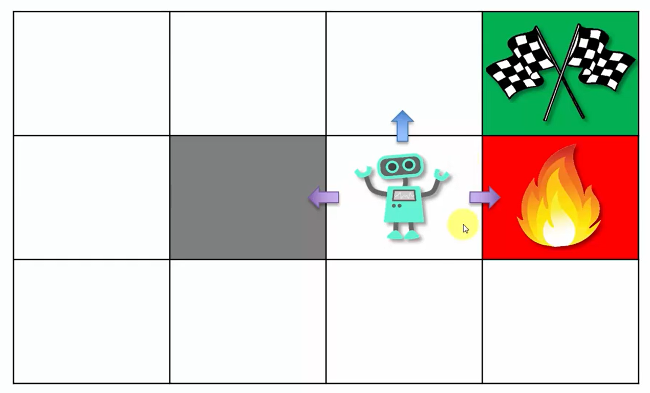
Definitions

Slide 4
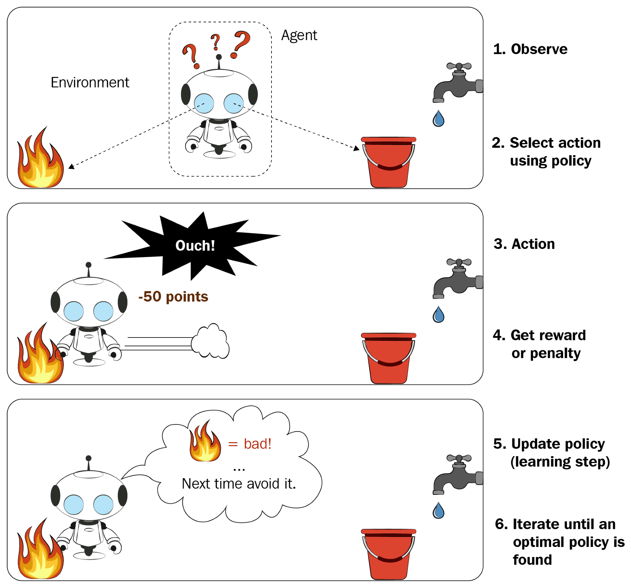
Learning Process Overview

Slide 5
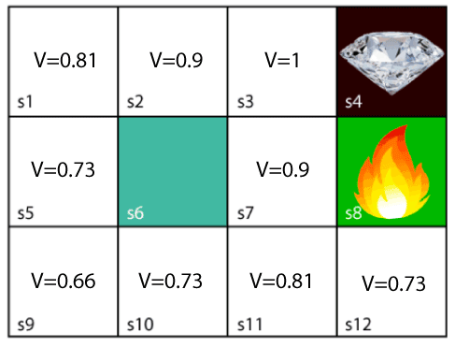
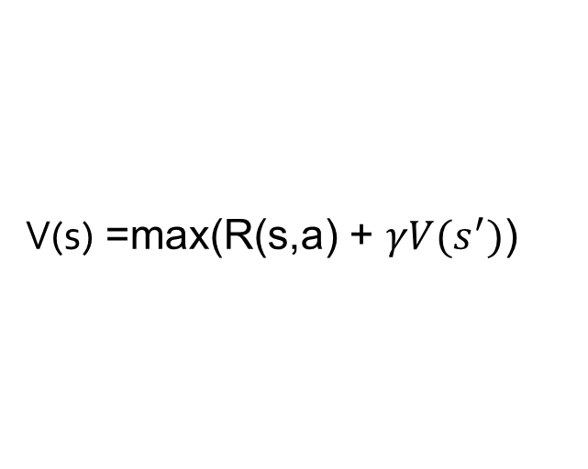
Bellman Equation
V(s) =max(R(s,a) + $γV(s^{′})$)

Slide 6
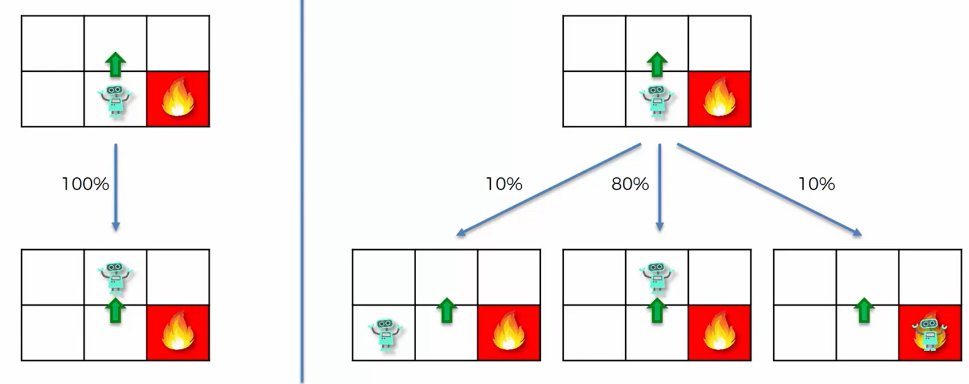
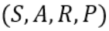
Markov Decision Process

Slide 7
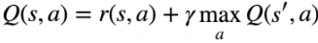
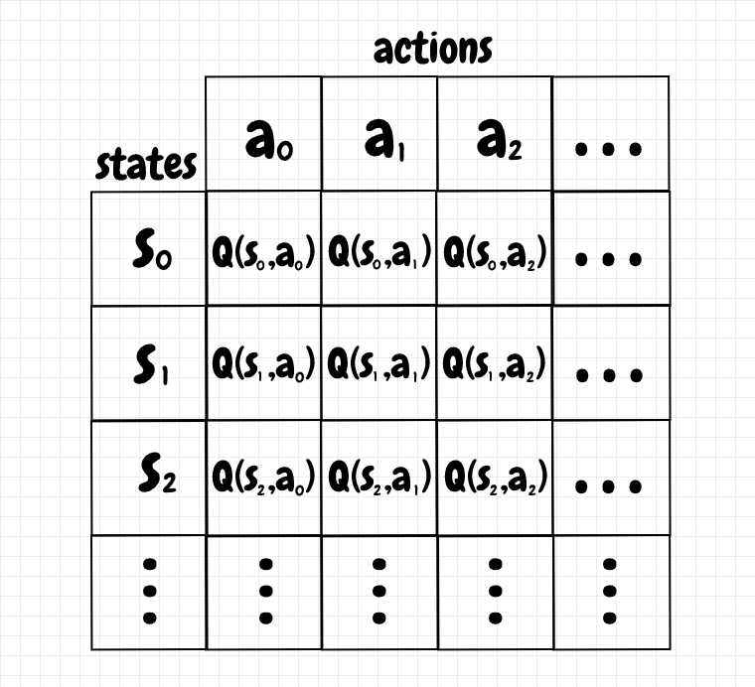
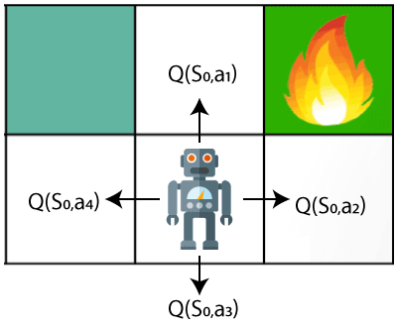
Q-learning

Slide 8
Update Q-values
Temporal Difference:
New Q-value:

Slide 9
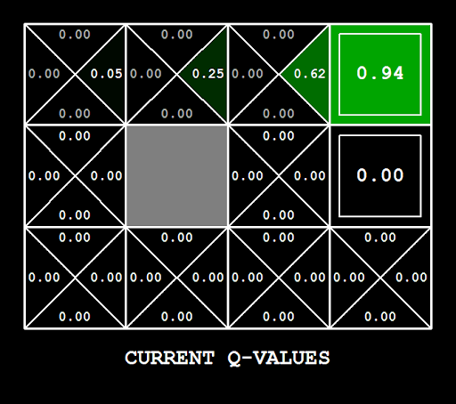
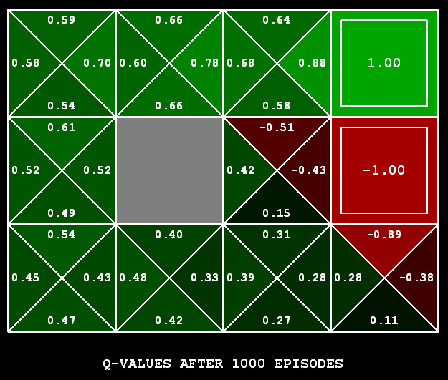

Slide 10
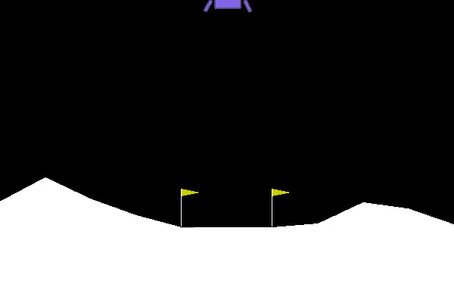
“LUNARLANDER-V2” by GYM
Landing pad is always at coordinates (0,0). Coordinates are the first two numbers in state vector. Reward for moving from the top of the screen to landing pad and zero speed is about 100..140 points. If lander moves away from landing pad it loses reward back. Episode finishes if the lander crashes or comes to rest, receiving additional -100 or +100 points. Each leg ground contact is +10. Firing main engine is -0.3 points each frame. Solved is 200 points. Landing outside landing pad is possible. Fuel is infinite, so an agent can learn to fly and then land on its first attempt. Four discrete actions available: do nothing, fire left orientation engine, fire main engine, fire right orientation engine.

Slide 11
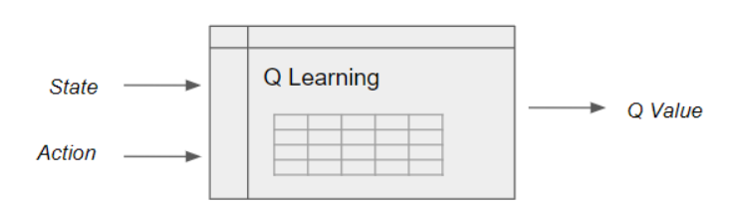
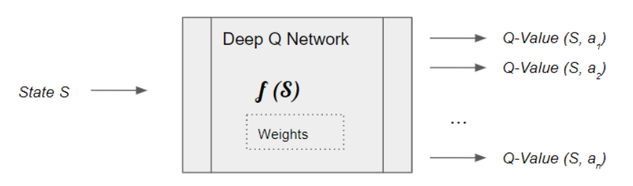
Deep Q learning

Slide 12
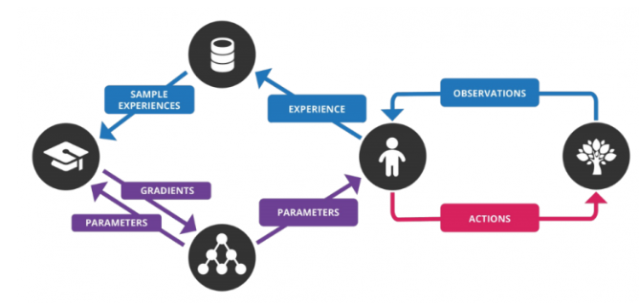
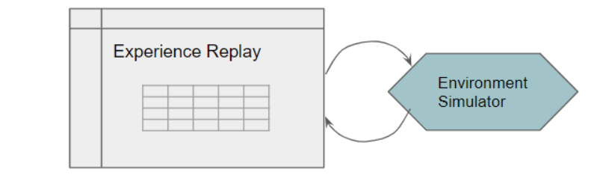
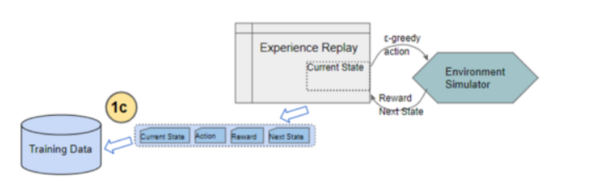

Slide 13
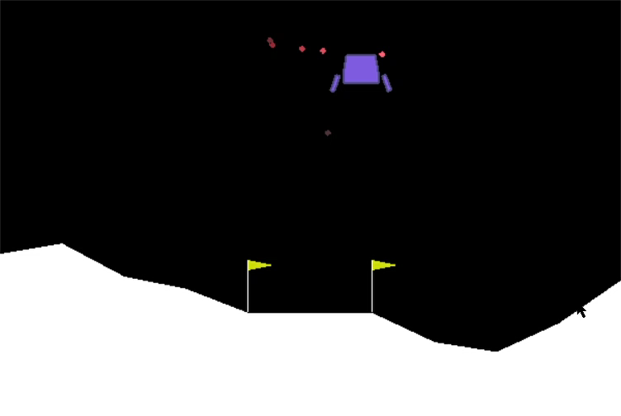
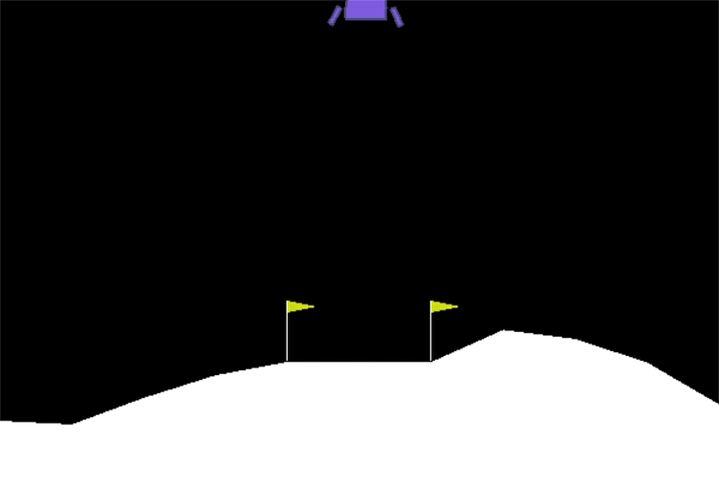
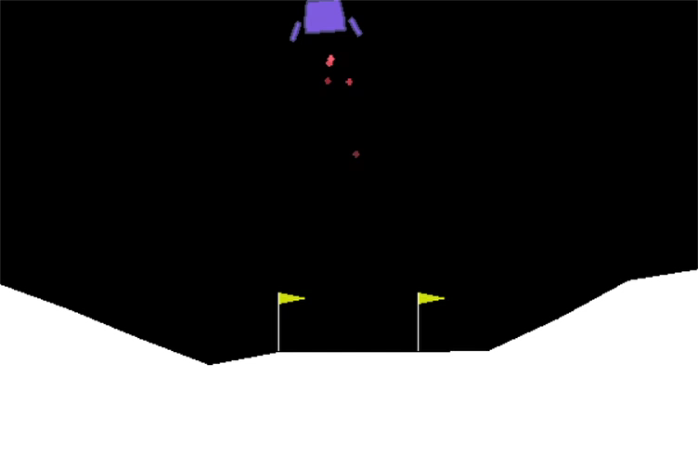
0 episodes
> 40 episodes
> 100 episodes

